Slide 1
How to search books
OPAC Guide

Slide 2
Features of Web OPAC

Slide 3
1
Web OPAC are accessible via Internet 24x7
2
Gateway to all Library resources- Books, Journals, e-books
3
offer Simple search and Advance/combination search options
Users can instantly check the status of books, such as whether they are available for borrowing
4
5
Users can perform searches using various search criteria such as Title, author, or keyword
6
Browsing capabilities (by Title, by author, by publisher, by subject)
7
New arrivals in the Library
View detailed information about each item including availability, location and call number
8

Slide 4
Demonstration for Users

Slide 5
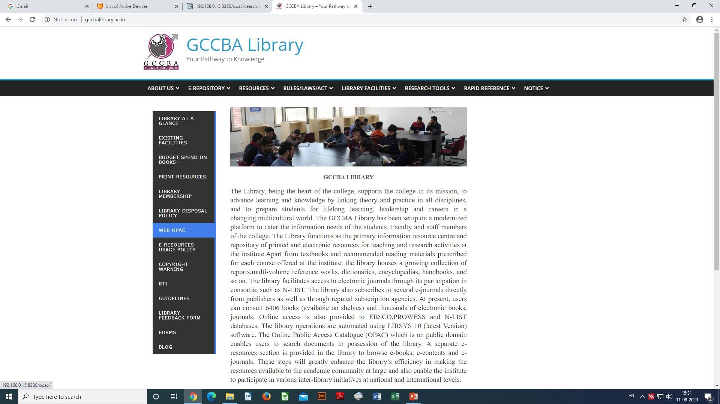
Library homepage
1

Slide 6
Login page
2

Slide 7
Login as Guest
3

Slide 8
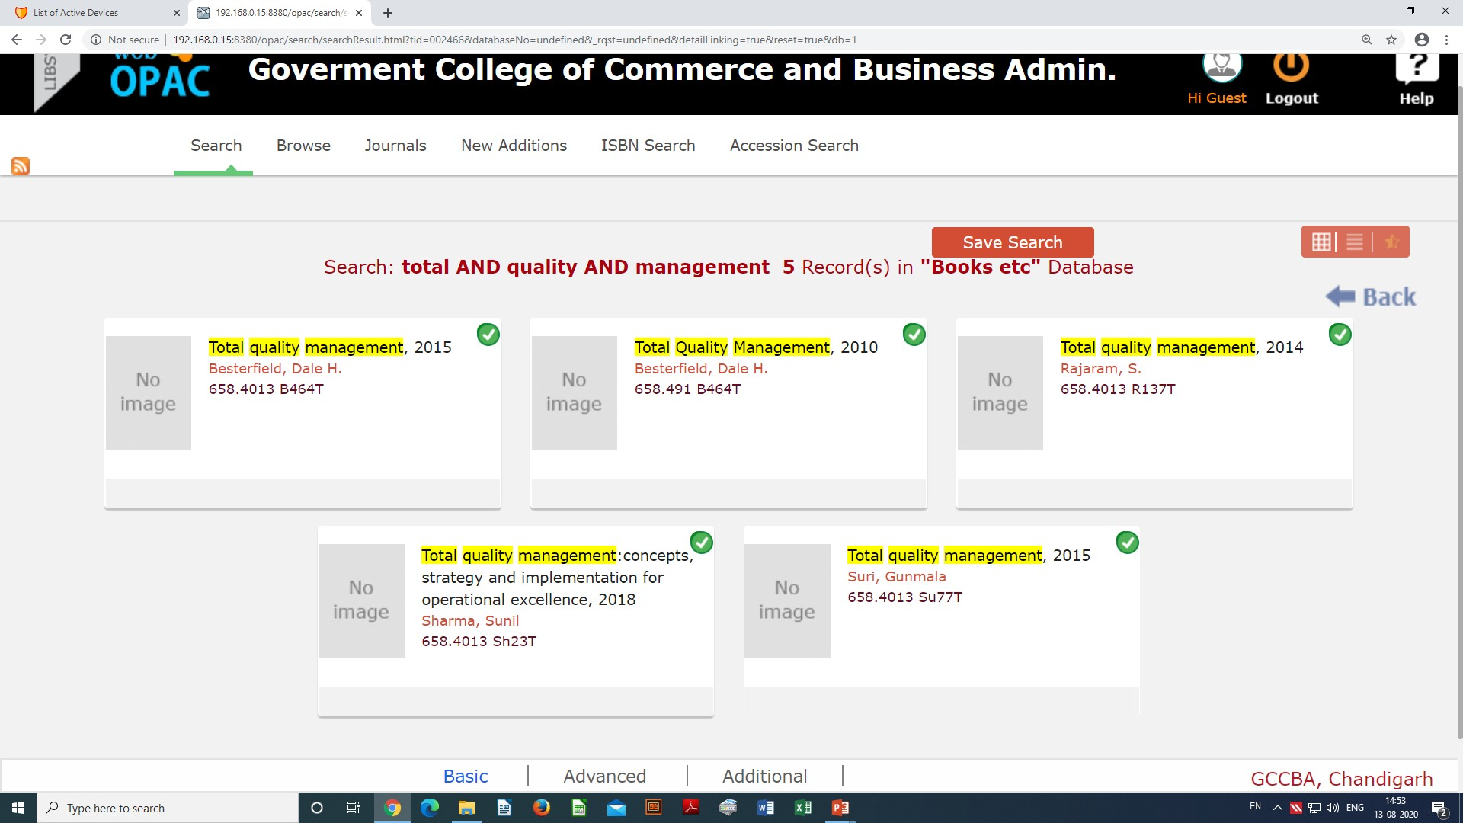
Search screen
you are logged in now
select search field option from this drop down menu
4

Slide 9
Select Title option
5

Slide 10
Enter your Title/Book name
click here
7
6

Slide 11
Appeared Titles/Search Result

Slide 12
Click on Preview for details
8
click here

Slide 13
Book Details
9
Bibliographic details

Slide 14
Locate Book on Shelf
9
Note the Call No. of the book to locate this book on shelves
10

Slide 15
Shelf Area

Slide 16
Thank you

